Slide 1
Twitch https://www.twitch.tv/
Kabore A. Rachid , Poda Yan-Tome, Sarah Slim

Slide 2
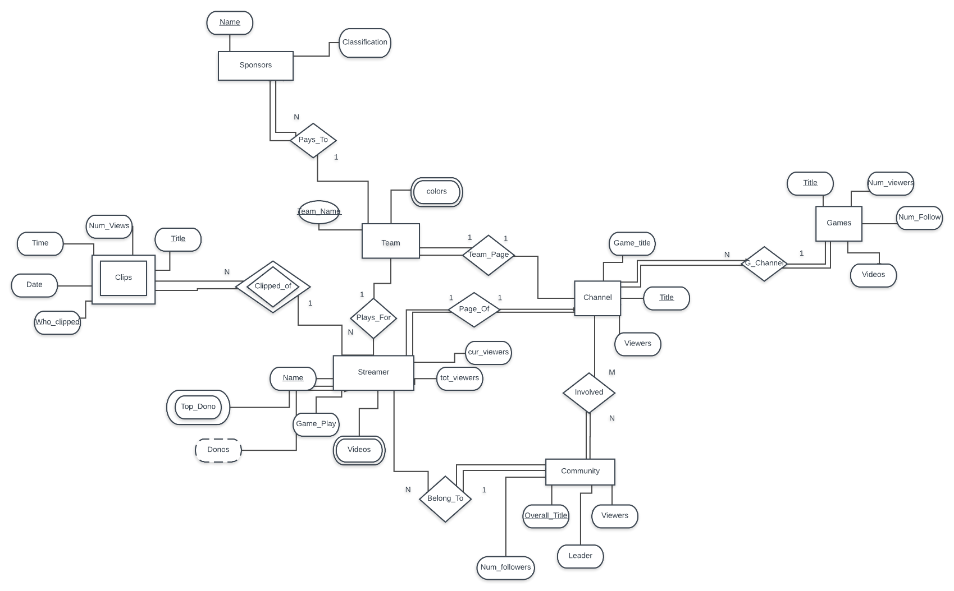
ER DIAGRAM

Slide 3
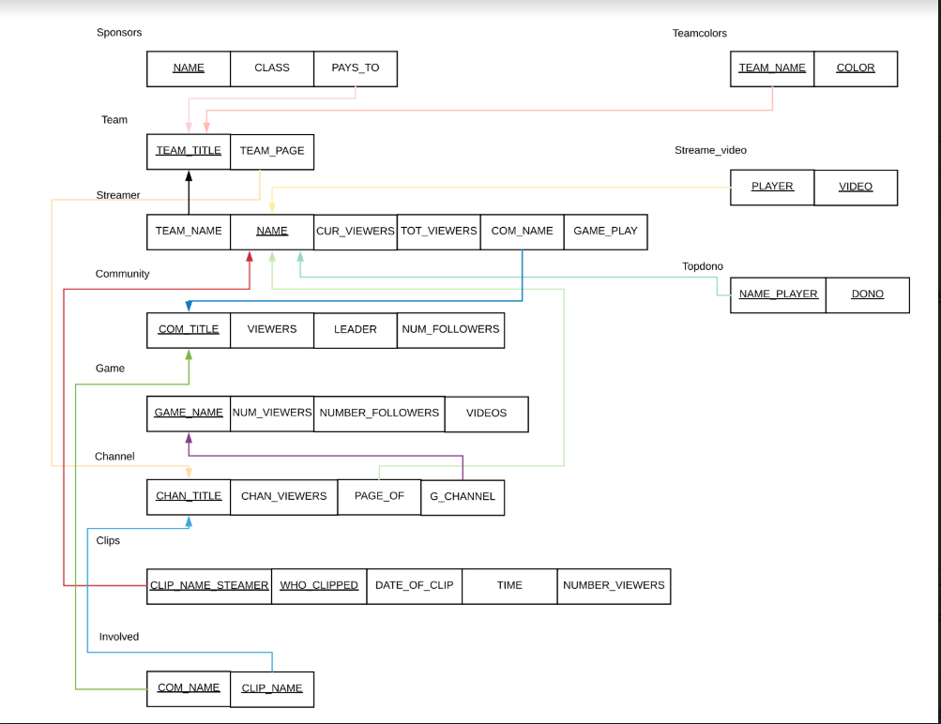
Relational Schema Diagram

Slide 4
Channel
Chan_title <- Title of channel
Chan_viewers<- current viewers of that channel
Page_of<- the streamer who runs that channel
G_channel<- name of the game on that channel

Slide 5
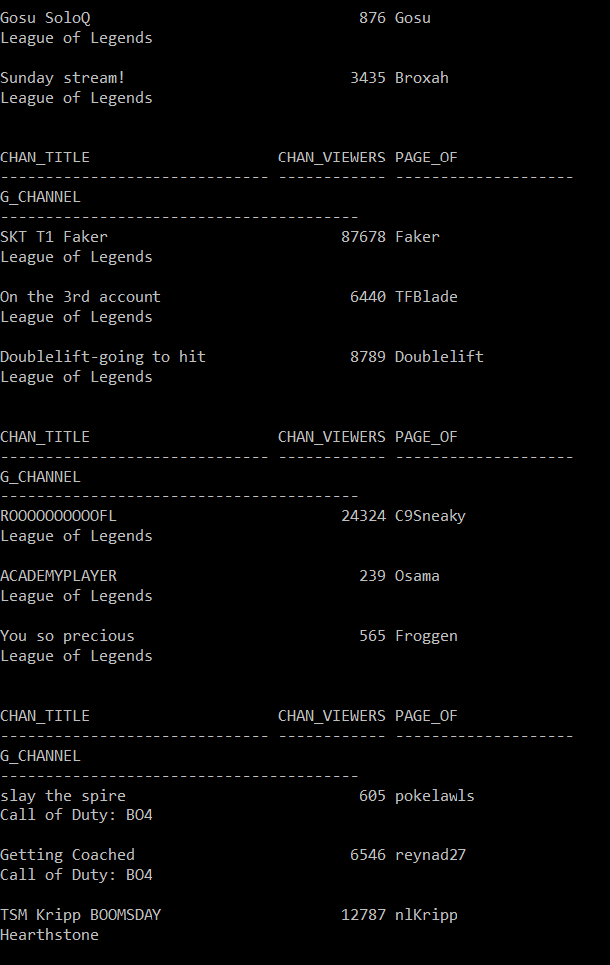
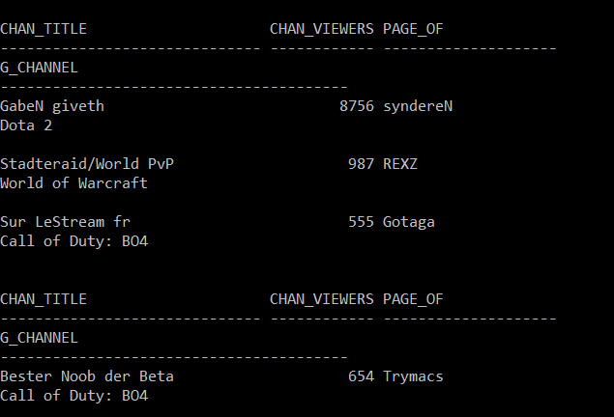
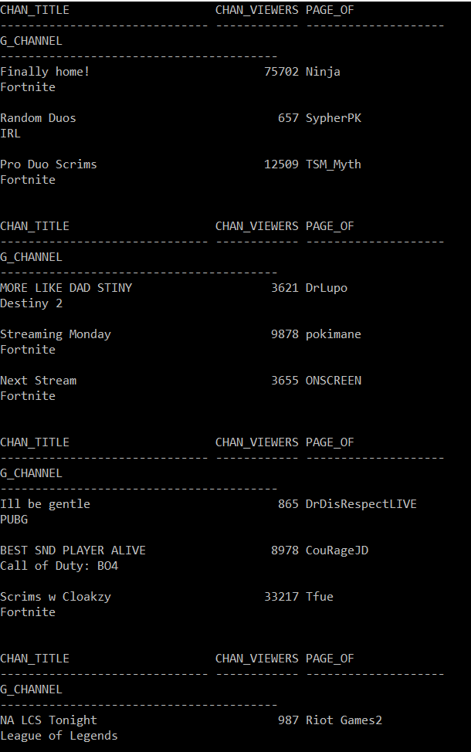
Channel

Slide 6
Clips
Clip_name_streamer<- streamer who the clip is of
Who_clipped<- the person who clipped it(can be anyone)
Date_of_clip<- date at which the clip was made
Time<- how long the clip is
Number_viewers<- number of people who have watched the clip

Slide 7
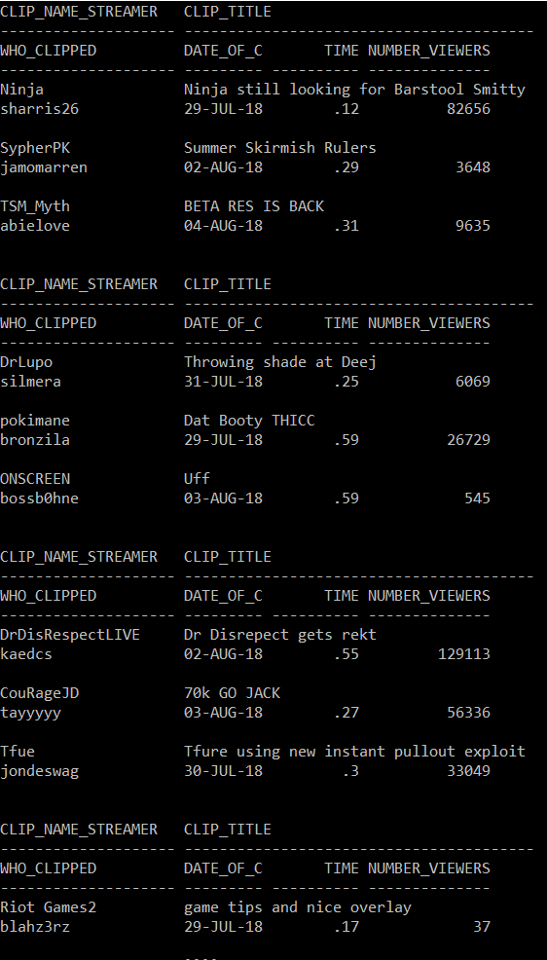
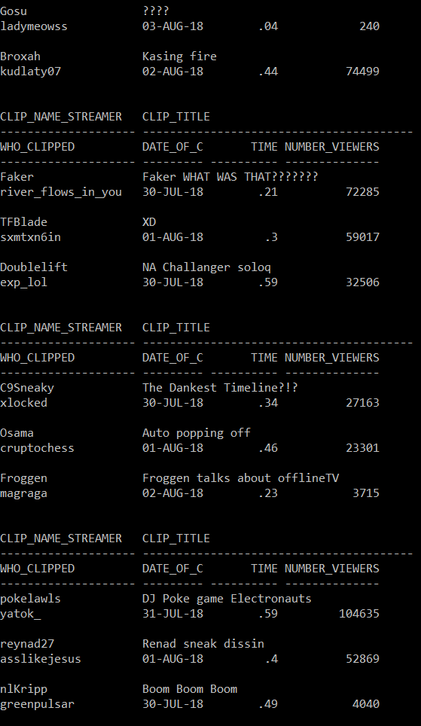
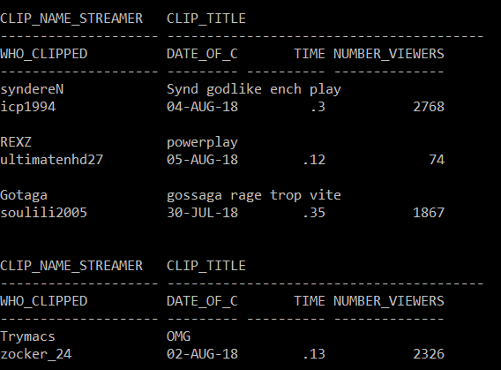
Clips

Slide 8
Community
Com_title<- name of the community
Viewers<- number of total viewers
Leader<- the person who is in charge of the community
Num_followers<- the total number of people who follow the channel

Slide 9
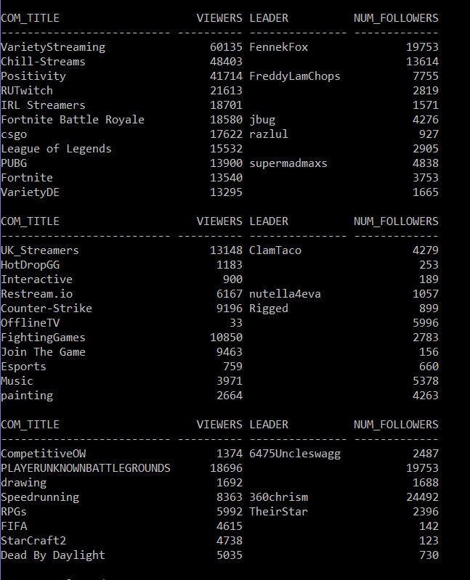
Community

Slide 10
Sponsors
Name<- the name of the sponsors
Class<- the classification of the sponsors for example a technology company
Pays_to<- the team they sponsor

Slide 11
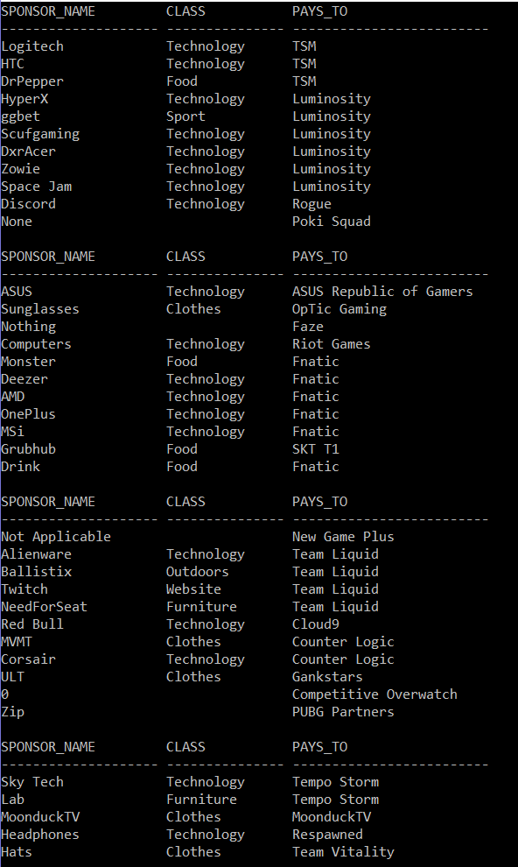
Sponsor

Slide 12
Streamer
Team_name<- if they are a professional gamer, the team they play for
Name<- the streamers name
Cur_viewers<- the current number of people watching the live stream
Tot_viewers<- the total number of people who have watched their channel
Com_name<- the community they are apart of if any
Game_play<-game they are playing

Slide 13
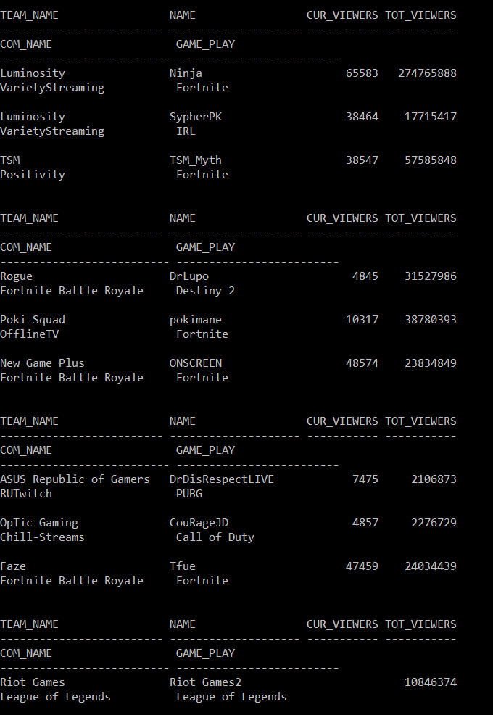
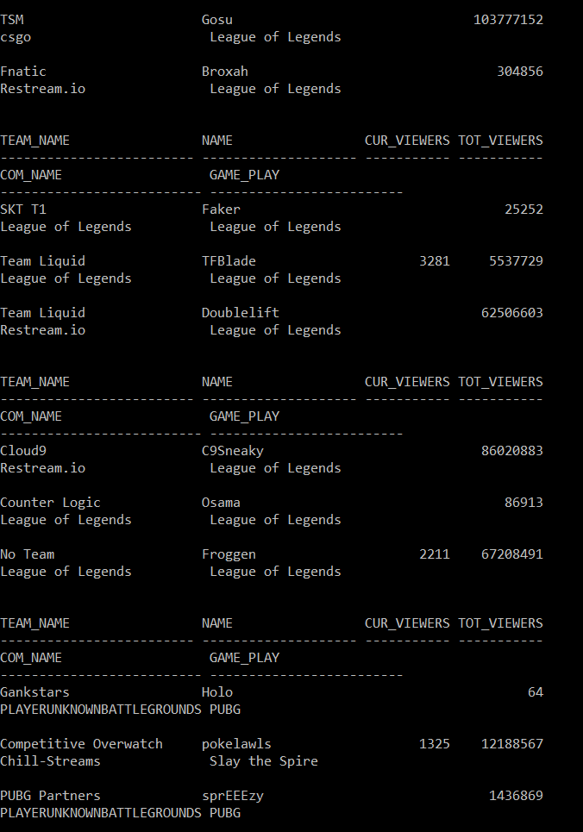
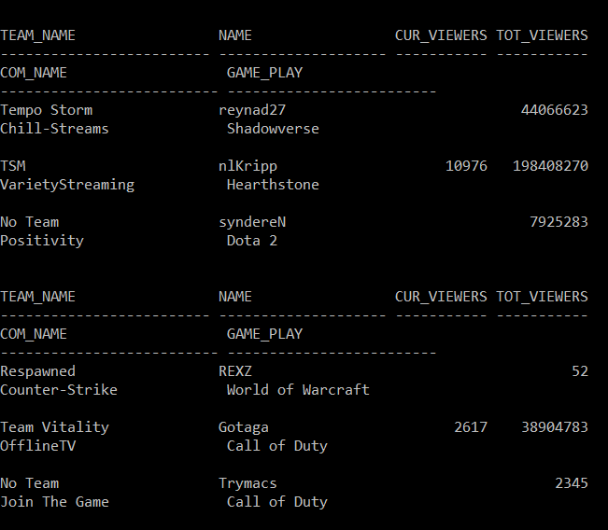
Streamer

Slide 14
Team
Team_title<- the team name
Team_page<- the channel for the team

Slide 15
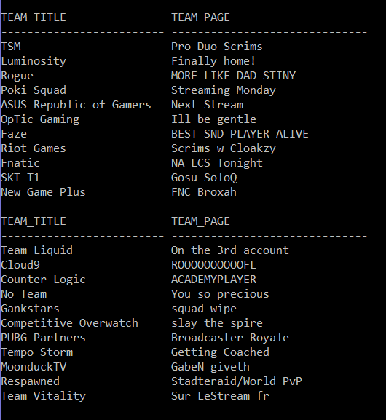
Team

Slide 16
Game
Game_name<- name of the game
Num_viewers<- current number of people watching that specific game
Number_followers<-the number of followers
Videos<- how many videos there are of that particular game

Slide 17
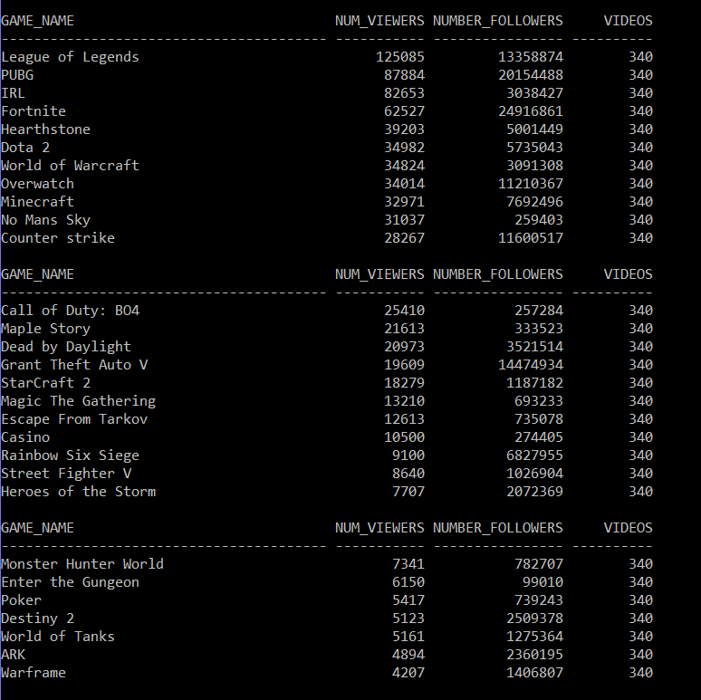
Game

Slide 18
Involved
Com_name<- the community name
Clip_name<- the unique name of the clip

Slide 19
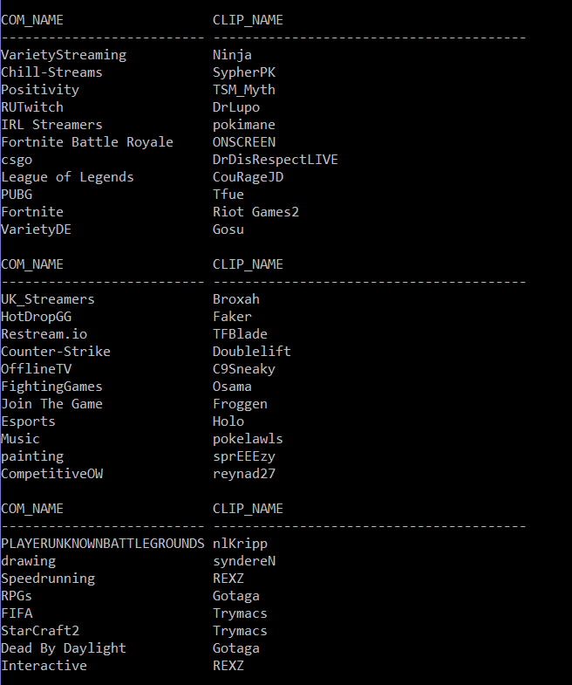
Involved

Slide 20
Teamcolor
Team_name<- name of the team
Color<- color of the team besides white

Slide 21
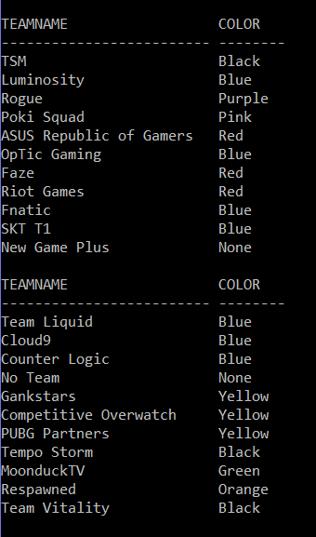
Teamcolor

Slide 22
Topdono
Name_player<- the name of the streamer
Dono<- the amount of money they received in donations

Slide 23
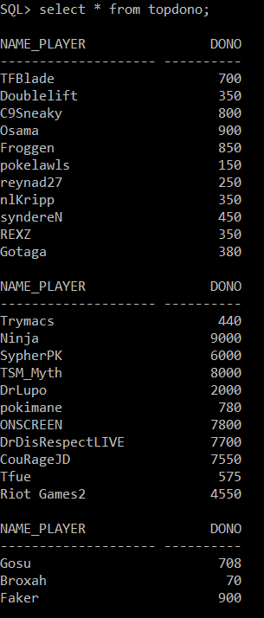
Topdono

Slide 24
Stream_video
Player<- name of streamer
Video<- the title of the video

Slide 25
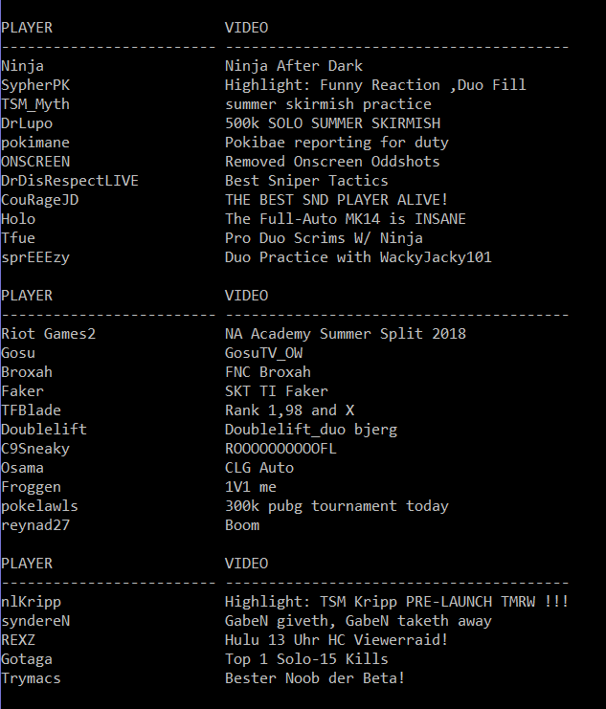
Stream_video

Slide 26


Queries 1/3 involving 2 Relations
List the teams whose team colors are not black or blue.
T1<- (color=‘Black OR color=‘Blue)(teamcolor)
Result<-  team_title(T1 team_name=team_title(team))

Slide 27
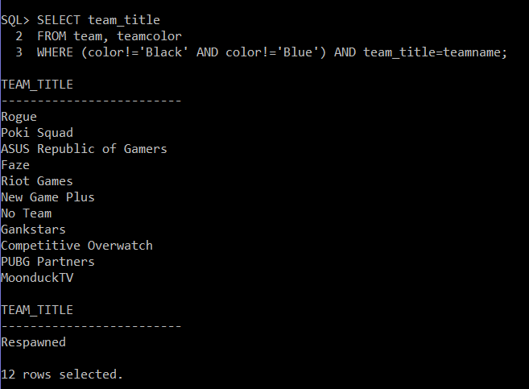

Slide 28
Queries 2/3 involving 2 Relations
List the streamers names who have more than 20,000 viewers, but less then 30,000 viewers.
T1<- number_viewers>10,000(clips)
Result<-  name(T1 clip_name_streamer=name(streamer)

Slide 29
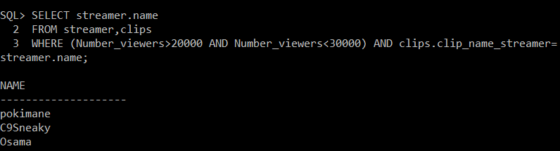

Slide 30
Queries 3/3 involving 2 Relations
List the team who are sponsored by a technology company
T1<- class=‘Technology’(sponsor)
Result<- team_title(T1 Pays_to=team_title(team)

Slide 31
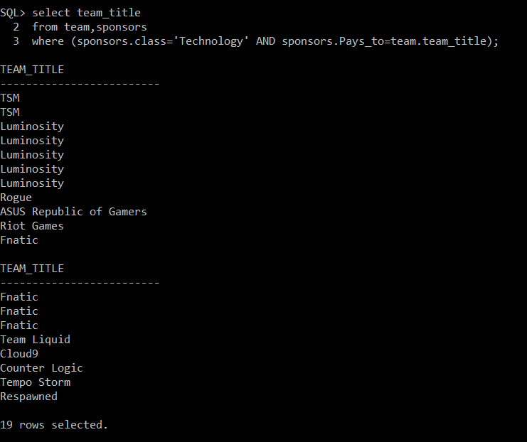

Slide 32
Queries 1/3 involving 3 Relations
List the streamers who play Fortnite with the number of viewers.
T1<- game_name=‘Fortnite’(game)
T2<-(T1 game_name=g_channel(channel)
Result<- name, cur_viewers(T2 page_of=name(streamer))

Slide 33
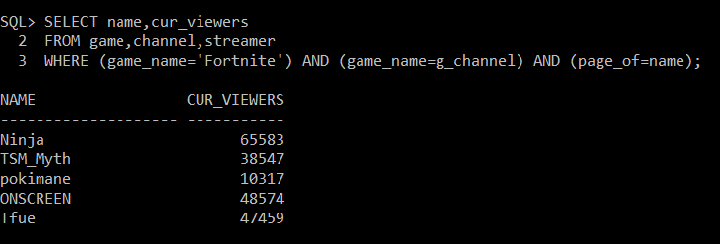

Slide 34
Queries 2/3 involving 3 Relations
Retrieve the names of streamers who are on Rogue.
T1<- team_page(team)
T2<- chan_title(channel)
T3<-T2-T1
Result<- name(T3 page_of=name(streamer)

Slide 35
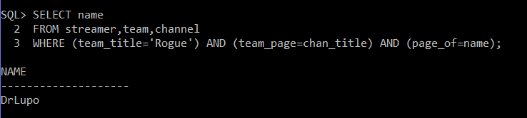

Slide 36
Queries 3/3 involving 3 Relations
Name the games of Poki Squad players.
T1<- team_title=‘Luminosity (team)
T2<- T1 team_page=chan_title(channel)
Result<- game_name(T2 g_channel=game_name(game)

Slide 37
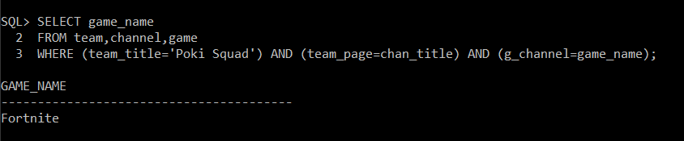

Slide 38
Queries 1/2 involving 4 relations
List the streamers and their channel title for their team color being blue.
T1<- color=‘Blue’(teamcolor)
T2<-T1 team_name=team_title(team)
T3<-T2 team_page=chan_title(channel)
T4<- name,chan_title(T3 page_of=name(streamer)

Slide 39
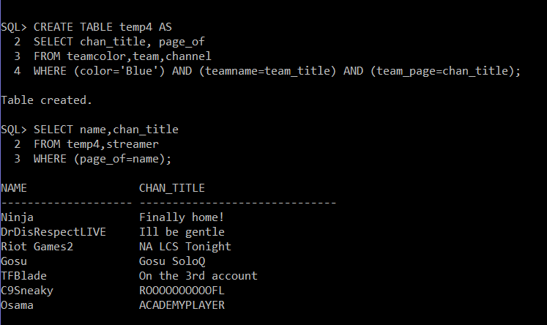

Slide 40
Queries 2/2 involving 4 relations
What are the donations for the TSM streamers?
T1<- team_title=‘TSM’(team)
T2<-T1 team_page=chan_title(channel)
T3<-T2 page_of=name(streamer)
T4<- dono(T3 name=name_player(topdono)

Slide 41
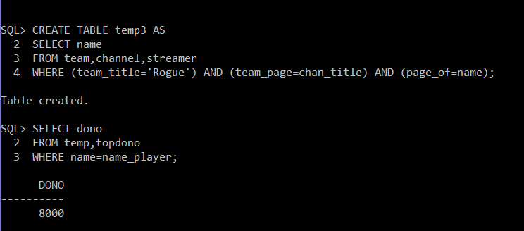

Slide 42
Pick 2 Queries 1/2
Name of Sponsors for team Counter Logic.
T1<- team_title=‘Counter Logic’(team)
T2<- sponsor_name(T1 team_title=Pays_to(Sponsor))

Slide 43
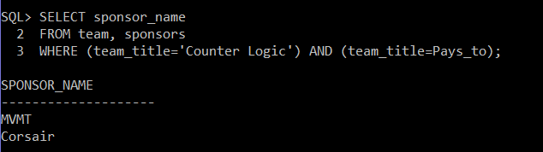

Slide 44
Pick 2 Queries 2/2
List the team names and total viewers for the game League of Legends.
T1<- game_name=‘League of Legends’
T2<- T1 game_name=g_channel(channel)
team_name,tot_viewers(T2 page_of=name(streamer)

Slide 45
